Slide 1
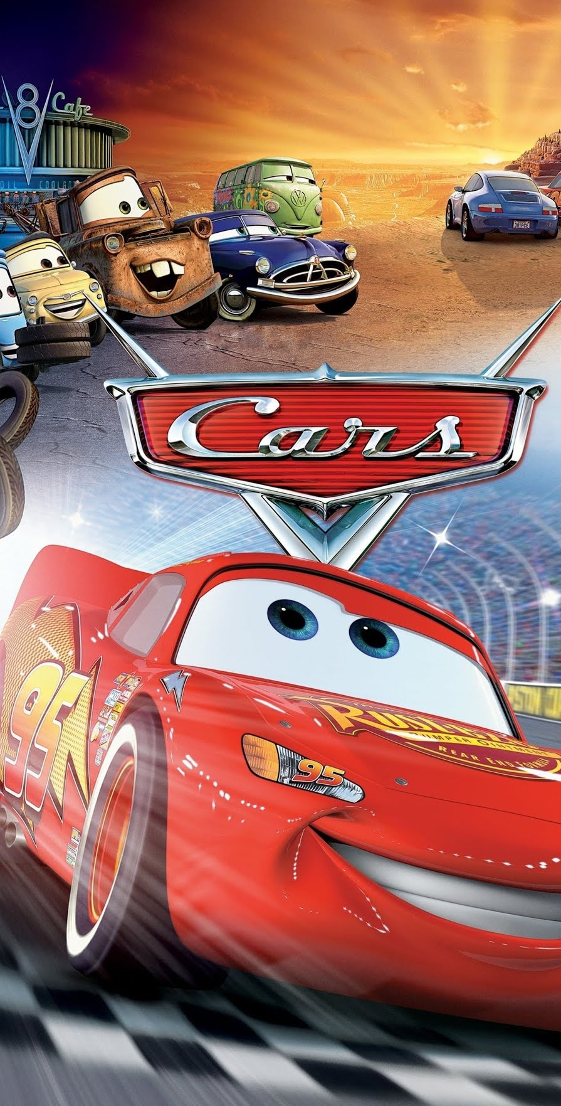
What Movie is the most similar to Cars?
Hunter Fristick

Slide 2

Algorithms to Analyze Text Data
TF-IDF
Used to find TF-IDF Score to compare documents
Cosine Similarity
Computes the distance between two vectors
Jaccard Distance
Compares items of two sets to see which are in both
MinHash
Quick when using large amounts of data

Slide 3
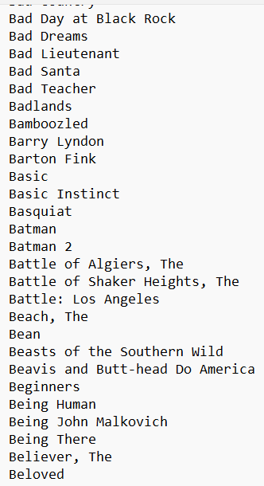
The Data
Two Data Sources
Script of Cars .txt file
Folder of 1093 movie scripts
.txt files from imsdb.com
Data scraped in 2017
Links to Data: Cars And Movie Scripts

Slide 4
Data Reading and Cleaning
Read in files from Google Drive
Separate each script into a list of words
Remove Stop Words found in nltk dataset
Took the stem of each word using PorterStemmer()
Append each script into a list of all scripts

Slide 5
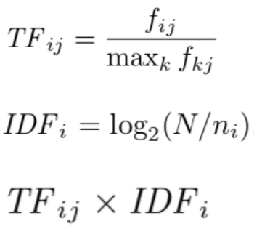
Computing TF-IDF
Term Frequency
Inverse Term Frequency
TF.IDF Score

Slide 6
Computing TF-IDF
Used TfidfVectorizer from sklearn to compute TF-IDF Values
Looped through scripts to compare to the Cars Script
Created a dateframe of each movie and their corresponding vectors

Slide 7
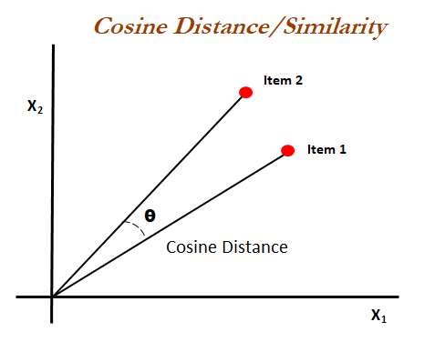
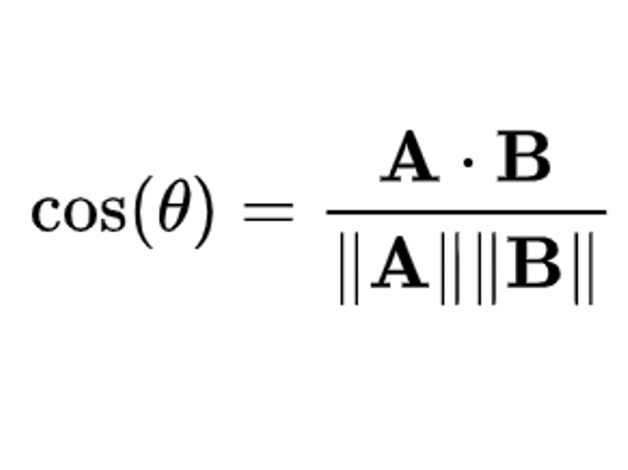
Computing Cosine Similarity

Slide 8
Computing Cosine Similarity
Imported cosine_similarity from sklearn.metrics
Output the cosine similarity of each script to a dictionary

Slide 9
Sorting DF
Changed cosine similarly dictionary into a df
Sorted by highest similarity value
Exported to a csv

Slide 10


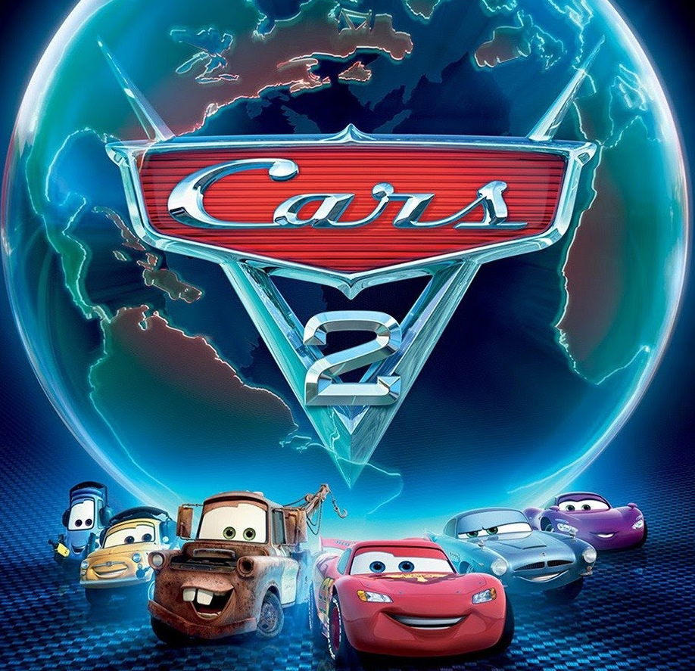
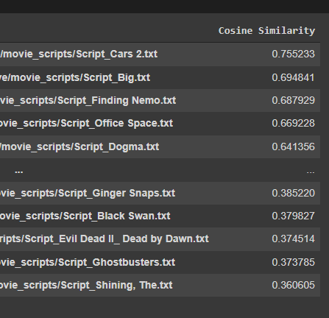
Results Based on Cosine Similarity
Top 3
Cars 2 - 0.755
Big - 0.694
Finding Nemo - 0.688
Least Similar
The Shining – 0.361
Ghostbusters - 0.377

